Slide 1
Linux 3b: Networking

Slide 2



What can you actually do with Linux?
Webservers
Fileserver
\\10.4.2.200
Minecraft Server
Remote Access (SSH)

Slide 3

How does all this work?
All these services connect through the Internet using
special addresses called IP addresses

Slide 4
Problems?
What if you want to host a web server and an ssh server on your Linux machine?
Website
Server
Client
192.168.1.2
Give the website on 192.168.1.2
Minecraft

Slide 5
Solution? Ports
Like sending mail to an apartment building, you have to specify address AND room number.
Here is the website on port 80
Website:80
Server
Client
192.168.1.2
Give me 192.168.1.2:80
Minecraft:25565

Slide 6
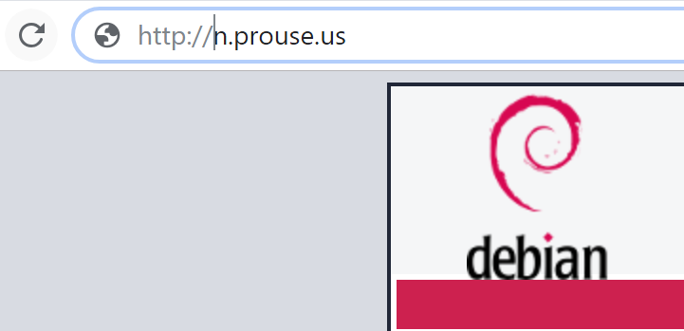
Real life example
When you connect to a website, you specify the port with http

Slide 7
Port in Linux
-t,
tcp
-u,
udp
-l, --listening
Show only listening sockets. (These are omitted by default.)
-p,
Show the PID and name of the program to which each socket belongs.
-n
Show numerical addresses instead of trying to determine symbolic host,
port or user names.
We view ports using the command netstat –tulpn
This shows us a the “open” ports on our machine

Slide 8
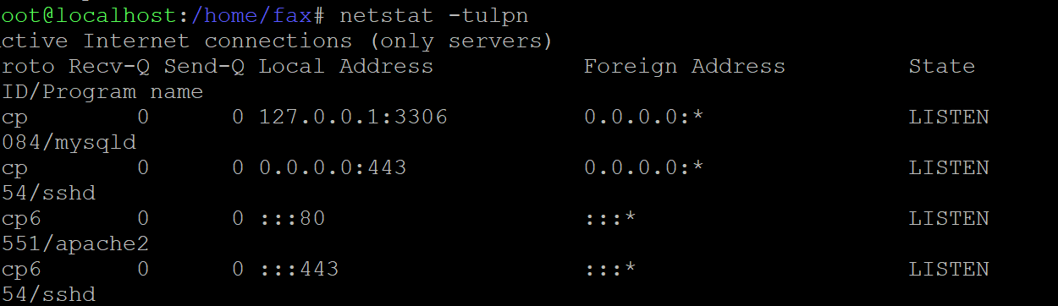

Slide 9
What Now?
Netstat can answer some questions for us.
What active services are running on this machine?
What backdoors are on this machine?
We only want authorized services!
Every LISTENING port should be authorized.

Slide 10
Handling Services
Use the service command to handle instances
Follows the following syntax:
service <service_name> <start/stop/start/restart>
For permanent removal use apt
apt remove <package_name>

Slide 11
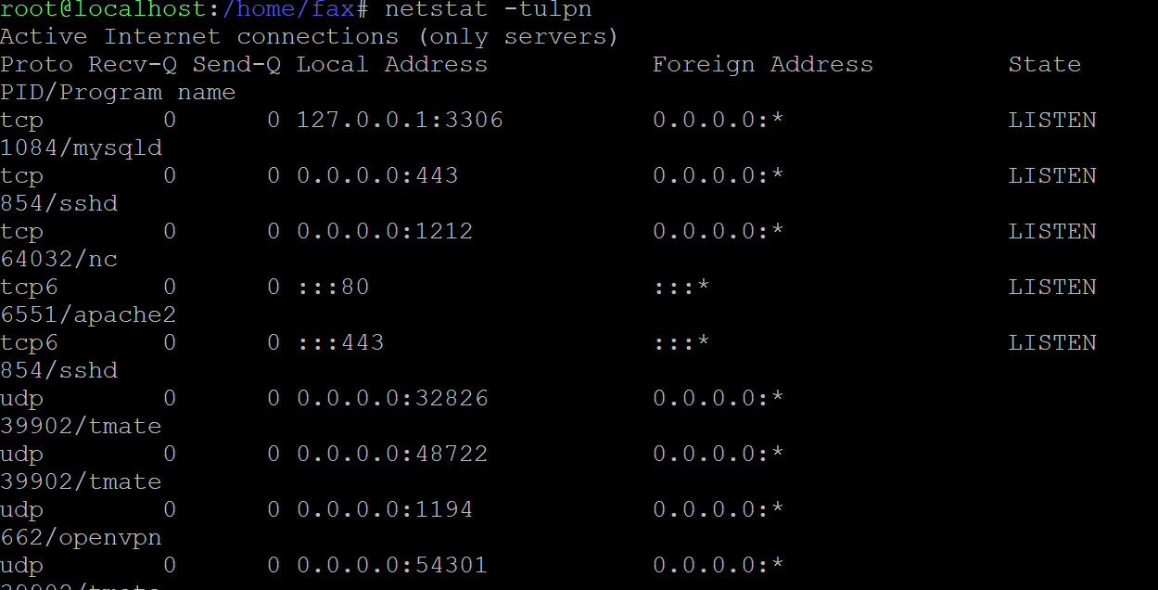
What is here?

Slide 12
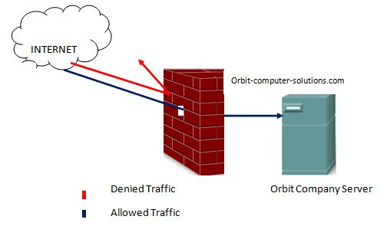
Firewalls
A firewall, like the one you installed in Round 1 (ufw) , limits the network requests coming to a network or a machine.
Firewalls often limit traffic by the type of request
Using PORTS

Slide 13
ufw
ufw enable
ufw status
ufw allow 22
ufw status numbered
ufw delete 1

